Slide 1
UNIT I – BASICS OF SDN
UNIT I – SESSION 1
SESSION 2
Need of SDN
Data Center Innovation
Data Center Needs
Reference: Ref. 1, Ch. 2.4, 2.5

Slide 2

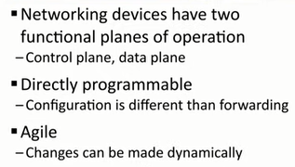
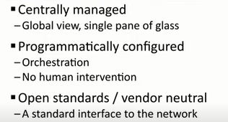
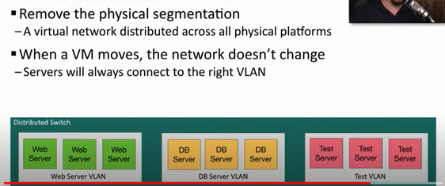
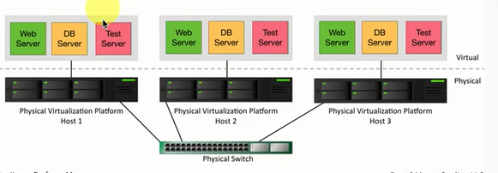
Virtualization

Slide 3
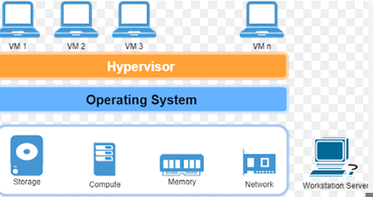
What is Virtualization?
Virtualization refers to the creation of virtual versions of various resources, such as hardware platforms, operating systems, storage devices, or network resources. These virtualized resources enable multiple instances or environments to run simultaneously on a single physical infrastructure, allowing for better resource utilization, flexibility, and efficiency
A hypervisor is a software layer that enables multiple operating systems to share a single hardware host. It's commonly used in virtualization technology to create and manage virtual machines (VMs) on a physical server
https://www.youtube.com/watch?v=UBVVq-xz5i0&t=81s
https://www.youtube.com/watch?v=sbefSsxlz0o&t=322s
https://www.youtube.com/watch?v=Wb68Exu6jtU&t=228s

Slide 4
Data Center Innovation

Slide 5
1. Compute and Storage Virtualization
Virtualization technology has been around for decades.
First commercially available VM technology for IBM mainframes was released in 1972, complete with the hypervisor and the ability to abstract the hardware below, allowing multiple heterogeneous instances of other operating systems to run above it in their own space.
In 1998 VMware was established and began to deliver software for virtualizing desktops as well as servers. .
Compute Virtualization
Later, data centers became prevalent and the need to dynamically create and tear down servers, as well as moving them from one physical server to another, became important.
Servers could be instantiated with a mouse click and could be moved without significantly disrupting the operation of the server being moved.
https://www.youtube.com/watch?v=gB8wQKCMjHM

Slide 6
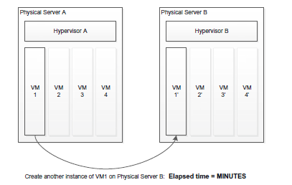
A physical server is divided into multiple virtual servers or virtual machines (VMs), each running its own operating system and applications.
Simple creation of a new instance of a virtual machine on a different physical server.
Creating a new VM or moving a VM from one physical server to another is a straightforward process from a server administrator’s perspective and may be accomplished very rapidly.
Virtualization software, such as VMware, Hyper-V, KVM, and Citrix, are examples of products that allow server administrators to readily create and move virtual machines.
These tools have reduced the time needed to start up a new instance of a server to a matter of minutes or even seconds.

Slide 7
Storage Virtualization
Likewise, storage virtualization has existed for quite some time, as has the concept of abstracting storage blocks and allowing them to be separated from the actual physical storage hardware.
As with servers, this achieves efficiency in terms of speed (e.g., moving frequently used data to a faster device) as well as in terms of utilization (e.g., allowing multiple servers to share the same physical storage device).
These technological advancements allow servers and storage to be manipulated quickly and efficiently.
https://www.youtube.com/watch?v=OUq-zNNTxBQ

Slide 8
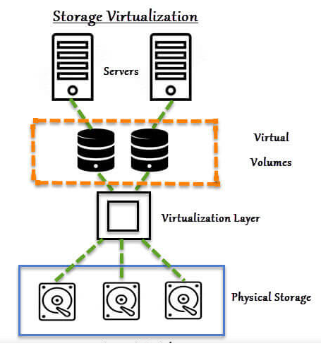
What is Storage Virtualization?
So, in simple terms Storage virtualization is the process of representing physical storage in the logical form to any server.
This logical storage will look like physical storage to a server or host, which means the server won’t be able to differentiate between physical storage and logical storage.
In storage virtualization, multiple physical disks are combined into a group and from that group of physical disks, virtual storage or logical storage blocks are assigned to a server for use.

Slide 9
2. Inadequacies in Networks Today
With the advent of data centers, there is a growing need for networks to not only recover from the events like hardware and software failures but also to be able to respond quickly to frequent and immediate changes.
Although the tasks of creating a new network, moving a new network, and removing a network are similar to those performed for servers and storage, doing so requires work orders, coordination between server and networking administrators, physical or logical coordination of links, network interface cards (NICs), and ToR switches, to name a few.
Therefore, the task of reconfiguring a network in a modern data center does not take minutes but rather days.
Such inflexible networks are hindering IT administrators in their attempts to automate and streamline their virtualized data center environments.
SDN holds the promise that the time required for such network reconfiguration be reduced to the order of minutes, such as is already the case for reconfiguration of VMs

Slide 10
Data Center Needs
New requirements emerging from the technological advances taking place now in data center environments.
https://www.youtube.com/watch?v=Amow8BJm5Go&t=86s

Slide 11
1. Automation
Automation allows networks to come and go at will, following the movements of servers and storage as needs change.
This is sometimes referred to as agility—the ability to dynamically instantiate networks and to disable them when they are no longer needed.
This must happen fast, efficiently, and with a minimum of human intervention.
Not only do networks come and go—they also tend to expand and contract.
Clearly, it may require a dynamic, agile, and automated network to keep pace with these changes.
Automation is crucial in data centers to streamline operations, reduce manual errors, and accelerate service delivery. SDN platforms offer automation and orchestration (automated arrangement, coordination, and management of complex systems or processes) capabilities that automate routine network management task

Slide 12
2. Scalability
Data centers need networking solutions that can scale seamlessly to accommodate growing numbers of servers, virtual machines, and applications. SDN provides centralized control and management, allowing administrators to easily scale network resources up or down based on demand.
The limitations of MAC address table sizes and number of VLANs have become impediments to network installations and deployments.
The large number of physical devices present in the data centers also poses a broadcast control problem.
The use of tunnels and virtual networks can contain the number of devices in a broadcast domain to a reasonable number.

Slide 13
3. Multipathing
The network must make optimal use of its resources, and it must be resistant to failures of any kind; and, if failures do occur, the network must be able to recover immediately.
Figure shows a simple example of multipath through a network, both for choosing the shortest path as well as for alternate or redundant paths.
Legacy layer two control plane software would block some of the alternate and redundant paths shown in the figure in order to eliminate forwarding loops. Because we are living with network technology invented years ago, the network is forced into a hierarchy that results in links that could have provided shortest-path routes between nodes lying entirely unused and dormant.
In cases of failure, the current hierarchy can reconfigure itself in a nondeterministic manner and with unacceptable latency.
The speed and high-availability requirements of the modern data center mandate that multiple paths not be wasted by being blocked and, instead, be put into use to improve efficiency as well as to achieve resiliency and load balancing

Slide 14
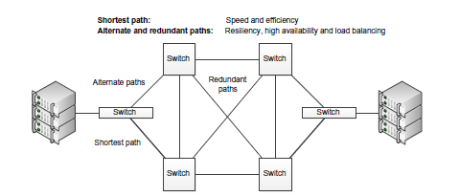
https://www.youtube.com/watch?v=IUTM76GLzMI

Slide 15
4. Multitenancy
With the advances in data center technology and the subsequent advent of cloud computing, the idea of hosting dozens or even hundreds or thousands of customers, or tenants, in the same physical data center has become a requirement.
One set of physical hardware hosting multiple users/organizations has been feasible for some time in the server and storage area.
Multitenancy implies that the data center has to provide each of its multiple users/organizations with its own (virtual) network that it can manage in a manner similar to the way it would manage a physical network
https://www.youtube.com/watch?v=60ccSmOxpMw

Slide 16
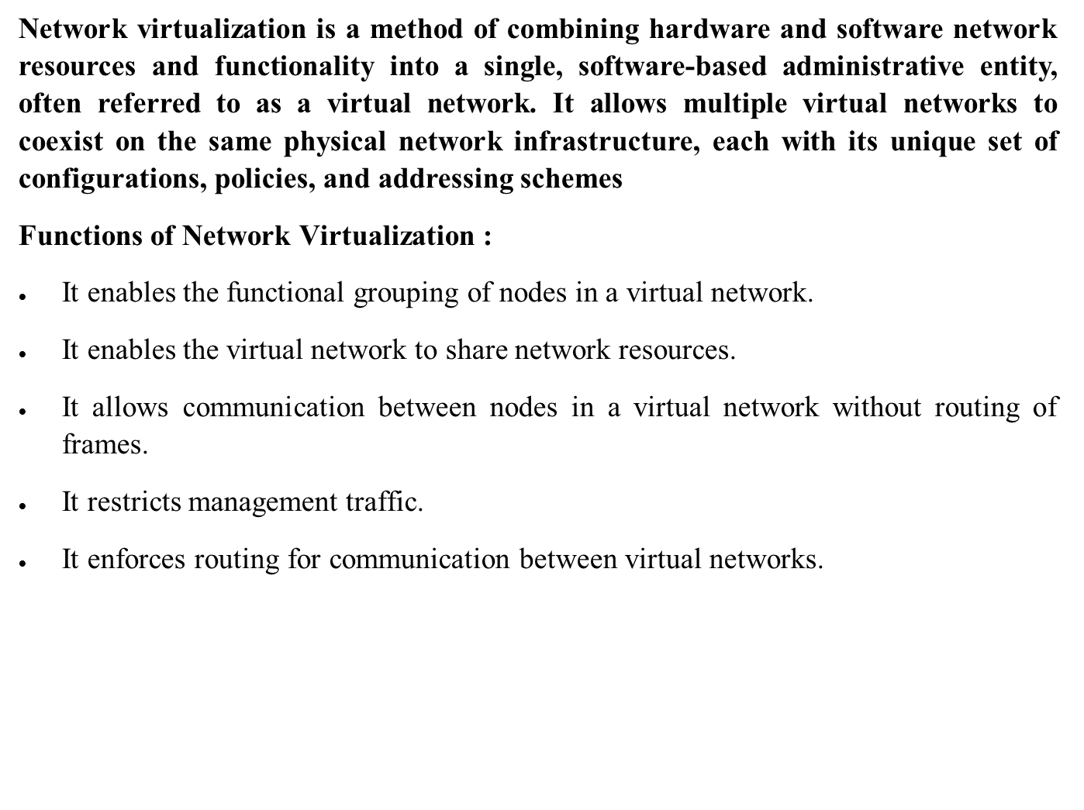
https://www.youtube.com/watch?v=HFQdbOY8Ams
https://www.youtube.com/watch?v=QE5y5PLqZZI&t=631s

Slide 17
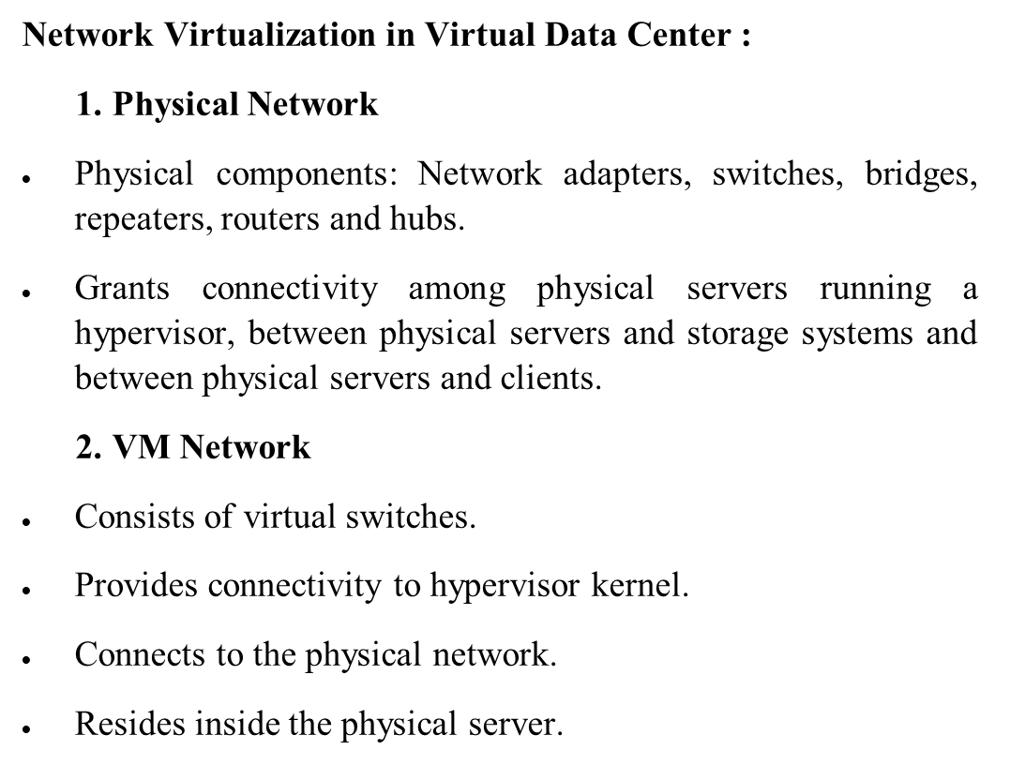
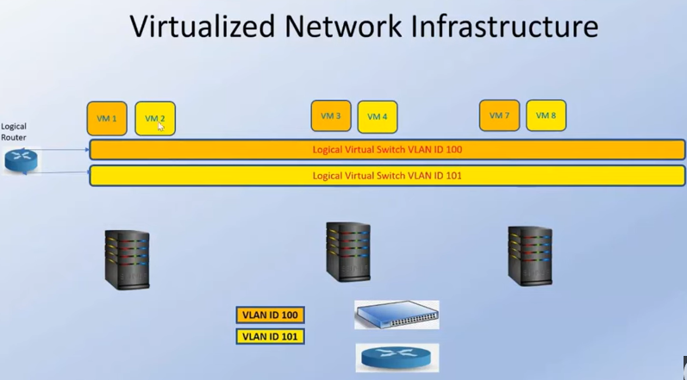

Slide 18
5. Network Virtualization
The urgency for automation, multitenancy, and multipathing has increased as a result of the scale and fluidity introduced by server and storage virtualization.
The general idea of virtualization is that you create a higher-level abstraction that runs on top of the actual physical entity you are abstracting.
The growth of compute and storage server virtualization has created demand for network virtualization.
This means having a virtual abstraction of a network running on top of the actual physical network.
With virtualization, the network administrator should be able to create a network anytime and anywhere he chooses, as well as expanding and contracting networks that already exist.

Slide 19
5. Network Virtualization
Intelligent virtualization software should be capable of this task without requiring the upper virtualized layer to be aware of what is occurring at the physical layer.
Server virtualization has caused the scale of networks to increase as well, and this increased scale has put pressure on layer two and layer three networks as they exist today.
Consequently, the degree of network virtualization required to keep pace with data center expansion and innovation is not possible with the network technology that is available today.

Slide 20
REVIEW QUESTIONS
Virtualization software, such as______, are examples of products that allow server administrators to readily create and move virtual machines.
New requirements emerging from the technological advances taking place now in data center environments are ______.
___________ is the ability to dynamically instantiate networks and to disable them when they are no longer needed.
_________ implies that the data center has to provide each of its multiple tenants with its own (virtual) network that it can manage in a manner similar to the way it would manage a physical network.
The growth of compute and storage server virtualization has created demand for ____________.

Slide 21
ANSWERS
VMware, Hyper-V, KVM, and Citrix
Automation, Scalability, multipathing, multitenancy, Network Virtualization
Agility
Multitenancy
Network virtualization.

